Slide 1
Lecture 8 - Review of Statistical Notation and Concepts
DS 4400: Machine Learning and Data Mining 1

Slide 2
Today
1 Today
Basic Statistical Concepts
Expectation and Variance
Expectation Variance
Bias Variance Tradeoff
Overfitting, Underfitting, and Model Selection

Slide 3
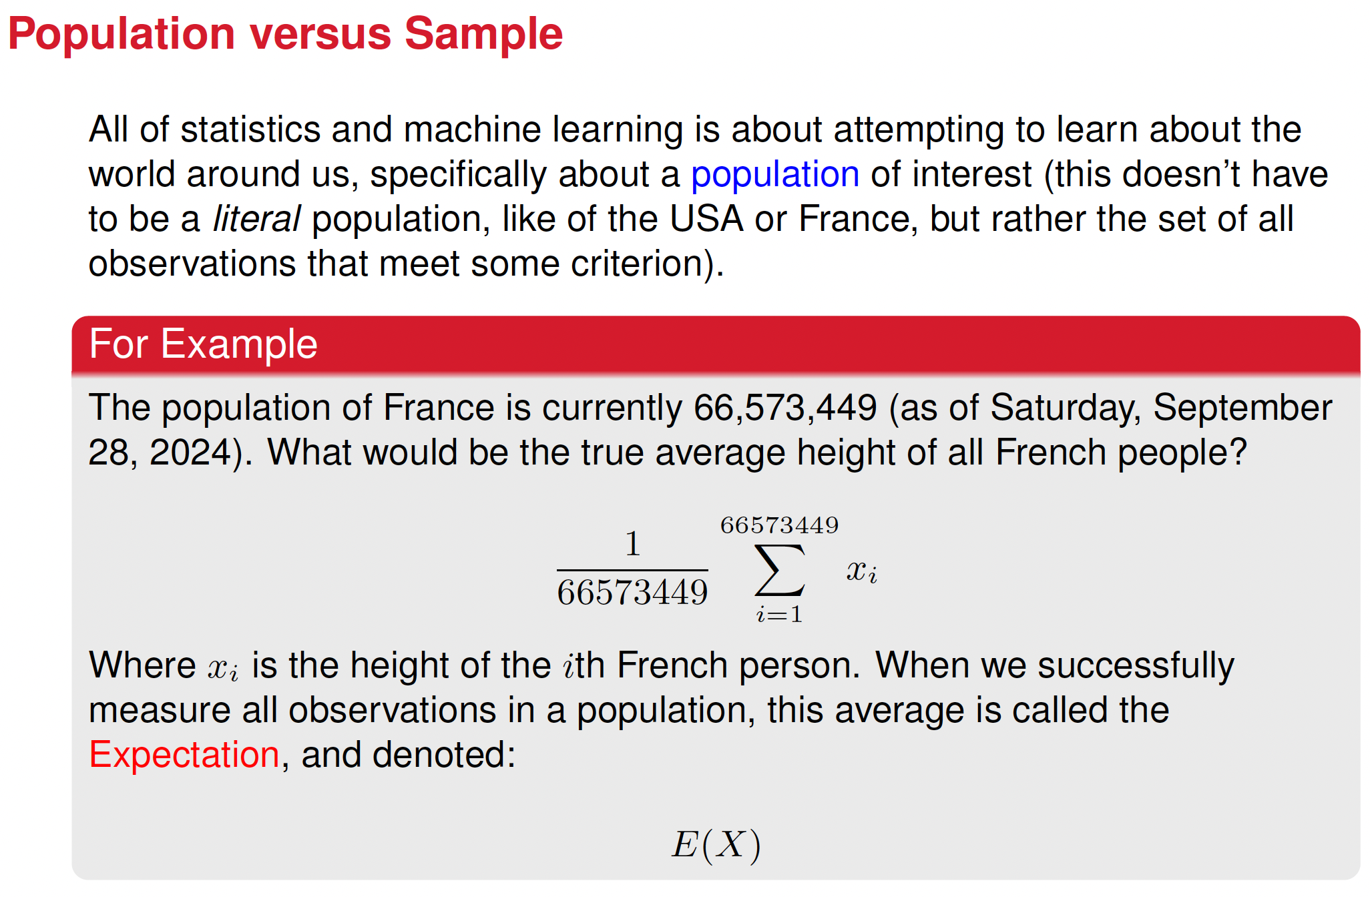

Slide 4
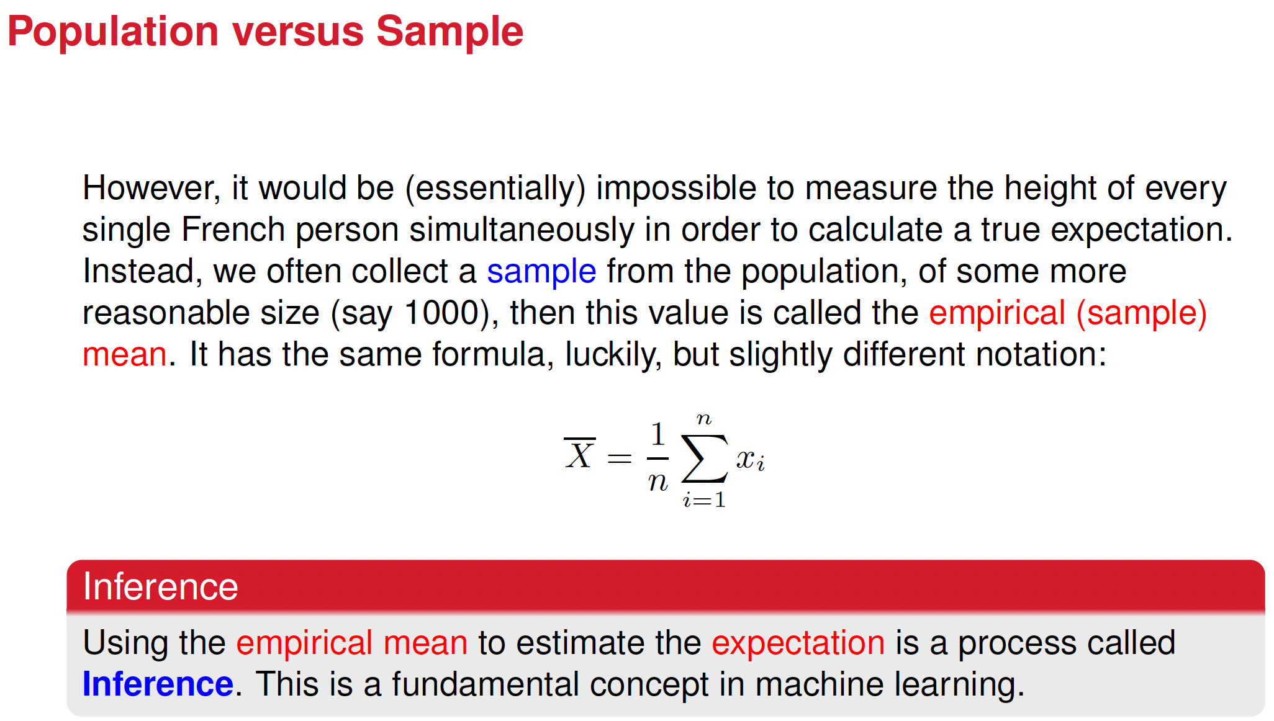

Slide 5
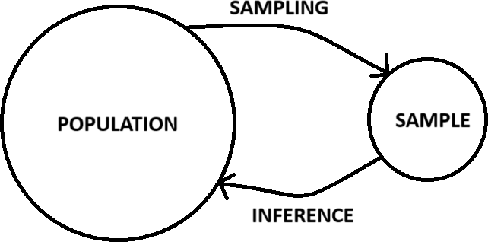
Inference
This might be the most important picture in all of statistics (and it’s so simple!)
How can we trust our inference? In other words, why would we trust that a sample of 1000 French people could give us a good approximation of the average height of all 66.6 million French people?

Slide 6
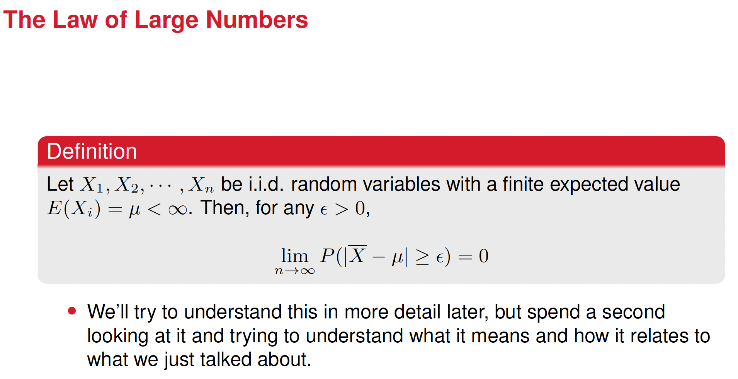




Slide 7
Explanation:
The formula states that as the sample size n increases, the probability that the sample mean X deviates from the expected value μ by more than some small positive number ϵ, approaches zero.
This means that for a sufficiently large n, the sample mean X is very likely to be close to the expected value μ. In other words, as n increases, the sample mean converges to the expected value.

Slide 8

Expected Value of a Random Variable X
Denoted as E(X), it represents the weighted average value of the outcomes of the variable when it's repeatedly measured over many trials
For a discrete variable X, E(X) is written as
Where P(X=x_{i}) stands for the probability of the x_{i} outcome.

Slide 9
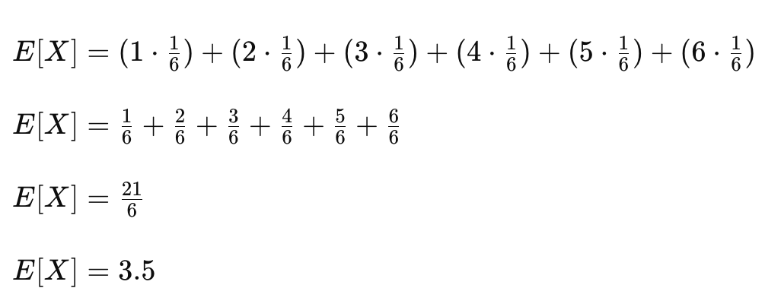
Example: Expected Value for rolling a fair die

Slide 10
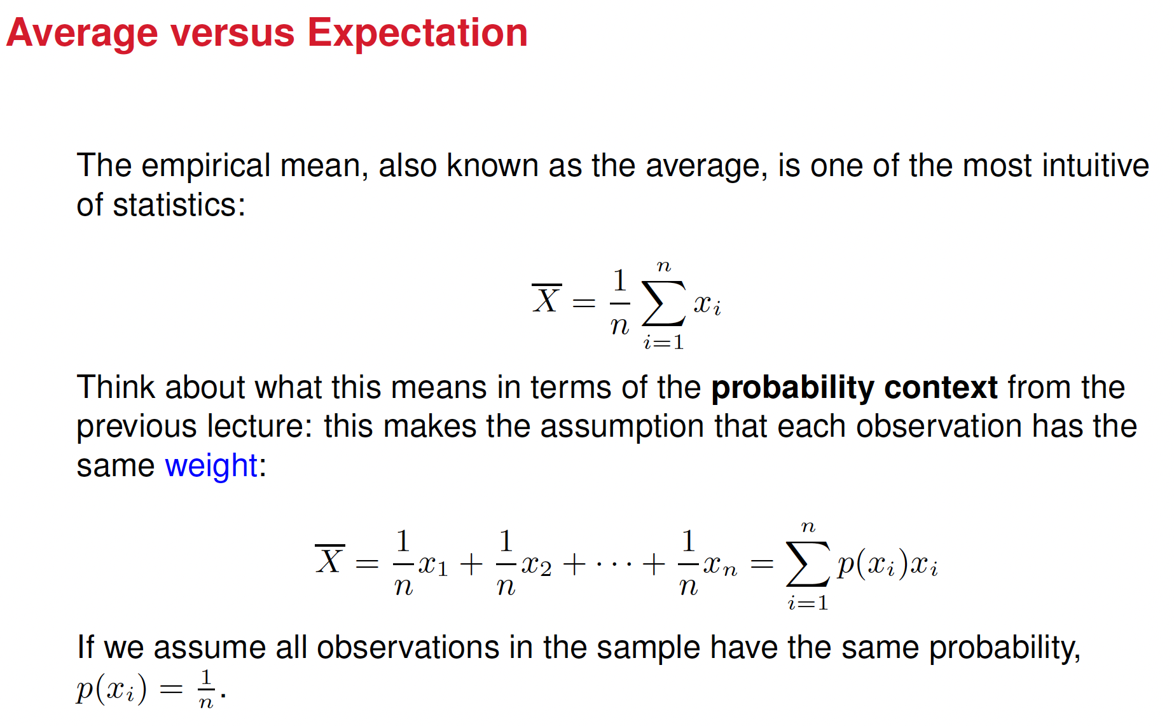

Slide 11
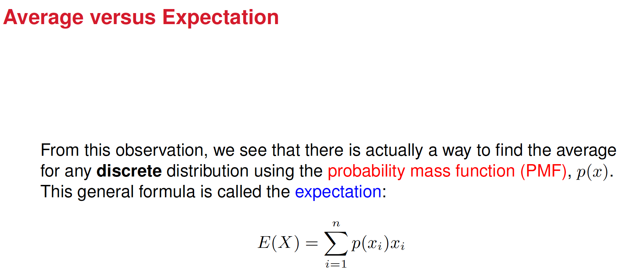

Slide 12
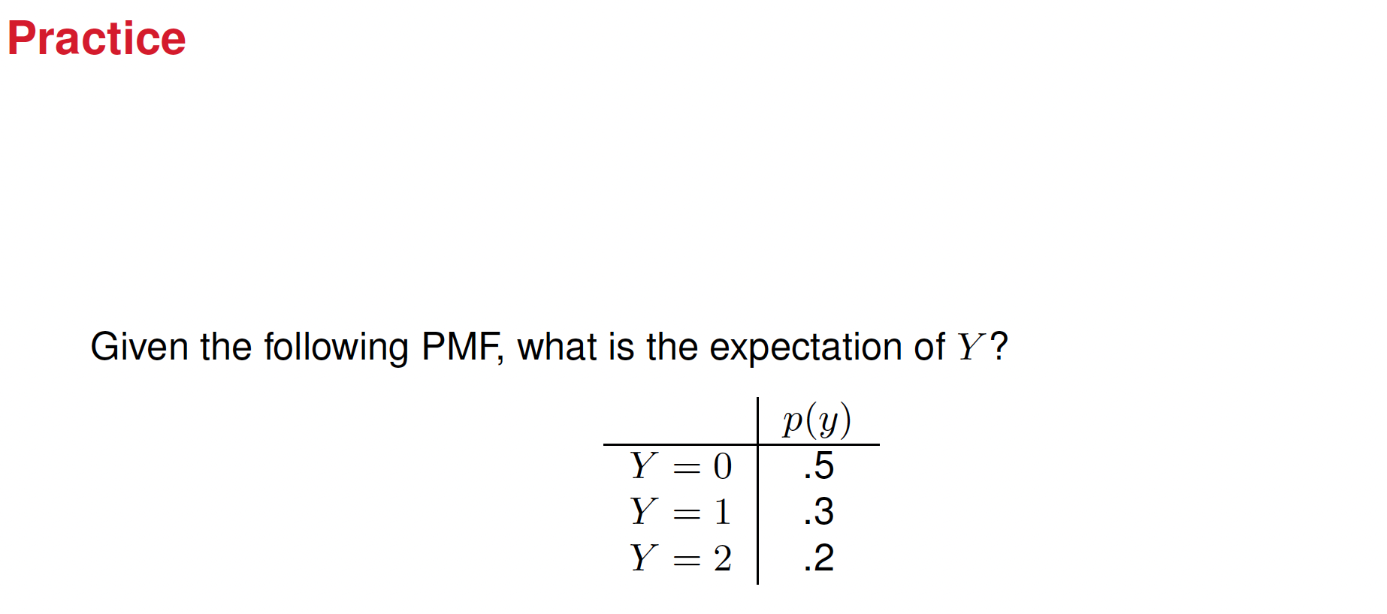

Slide 13
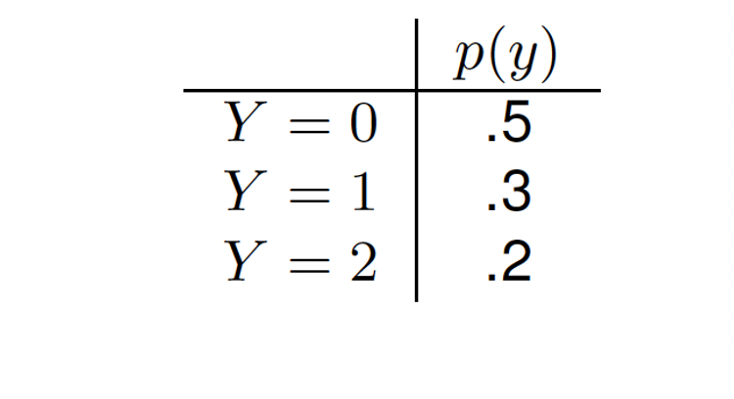









Slide 14
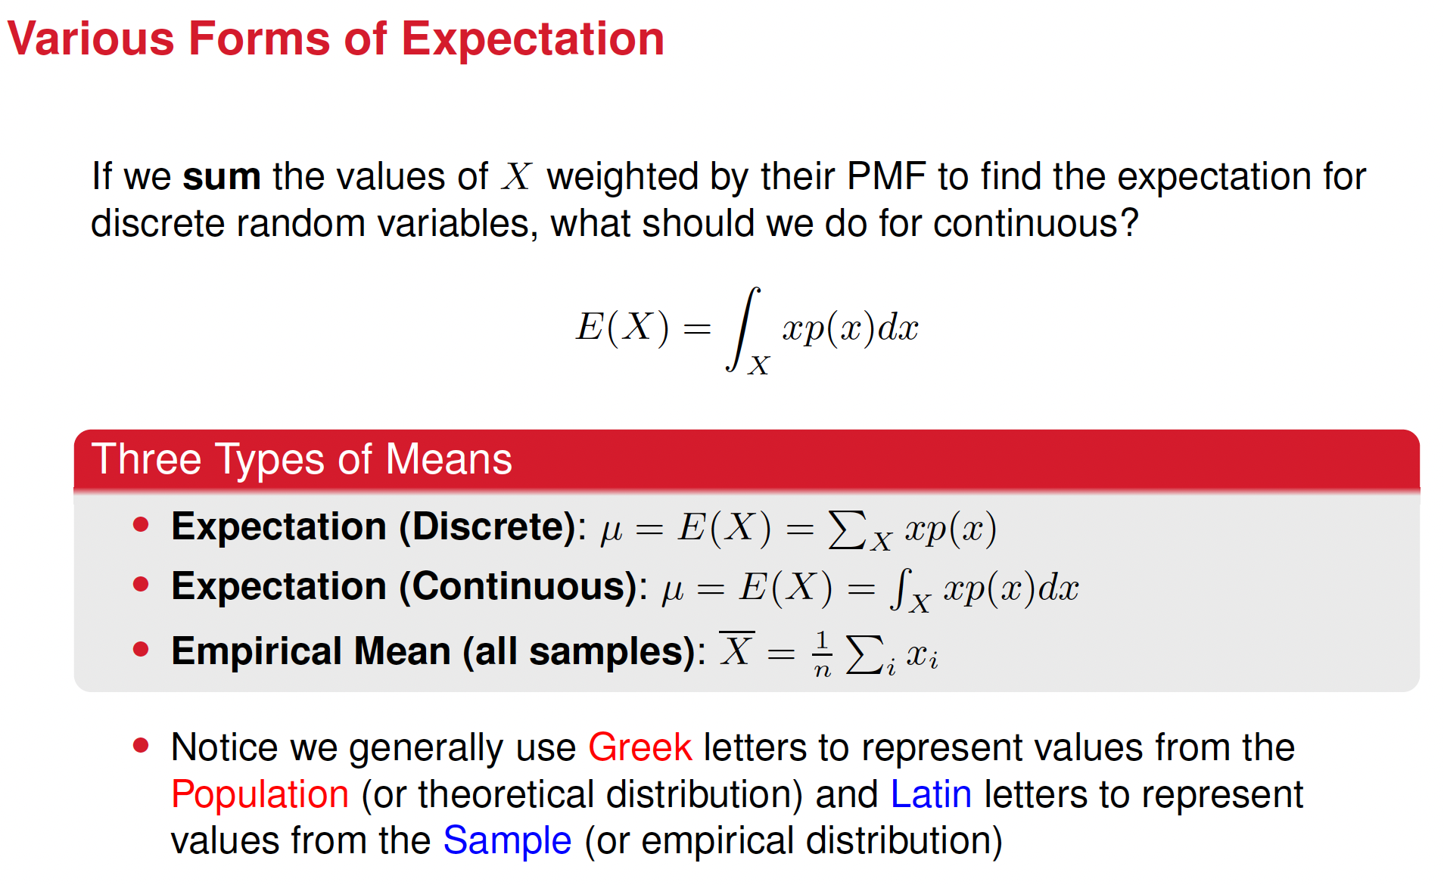

Slide 15
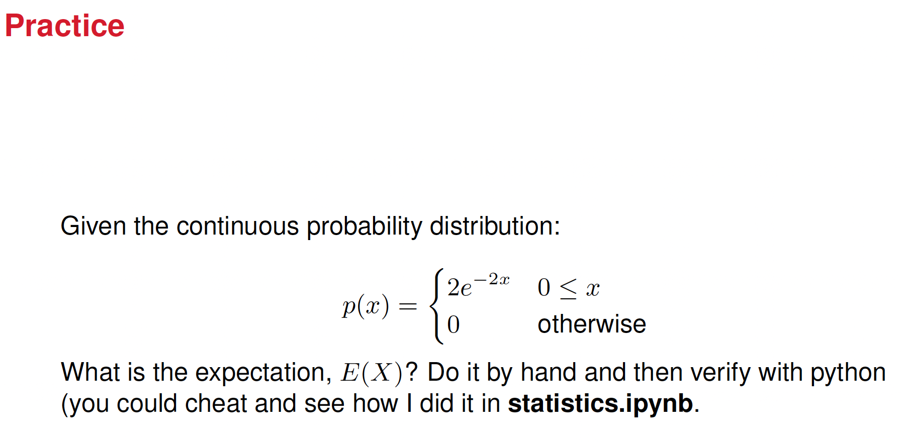

Slide 16
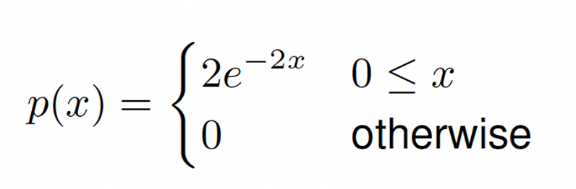















Slide 17

Variance of a Random Variable X, Var(X)
Measures the spread of data around the mean
It’s calculated as follows:
The Variance of X is the expected value of the squared deviations of X from its mean (i.e. Expected Value).

Slide 18





Visual representation of variance

Slide 19

Summarizing
Thus, the Variance can be also calculated as the difference between the expected value of X² and the square of the expected value of X.

Slide 20





































Let’s elaborate the Var(X) formula

Slide 21

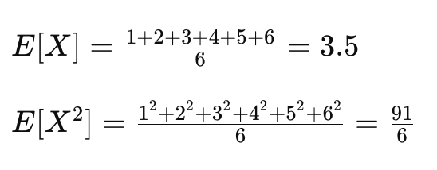
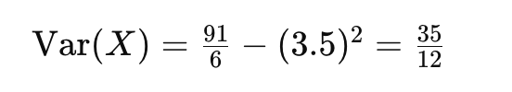



Example: compute the variance for a six-sided fair die

Slide 22
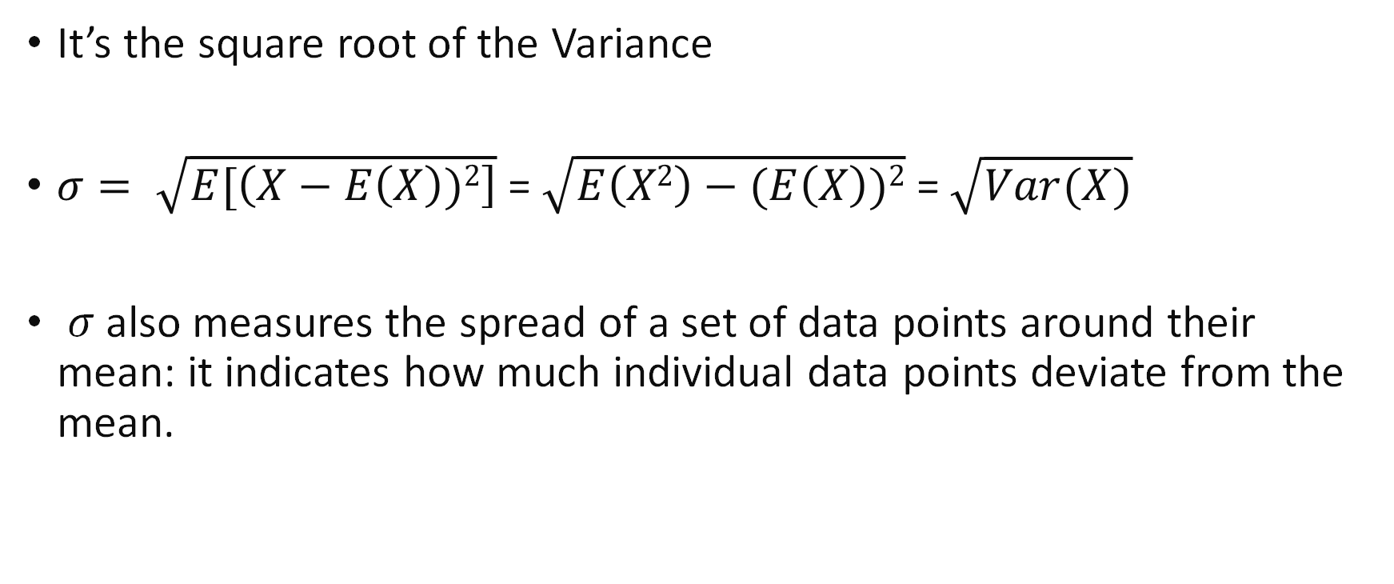
Standard Deviation
It’s the square root of the Variance
$σ= \sqrt{E[\left(X−E\left(X\right))2\right]}$ = $\sqrt{E\left(X2\right)−(E\left(X\right))2}$ = $\sqrt{Var(X)}$
𝜎 also measures the spread of a set of data points around their mean: it indicates how much individual data points deviate from the mean.

Slide 23
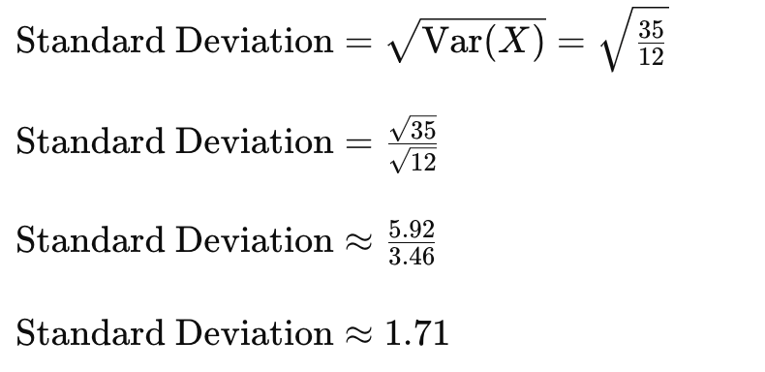
Compute the standard deviation for a six-sided fair die

Slide 24
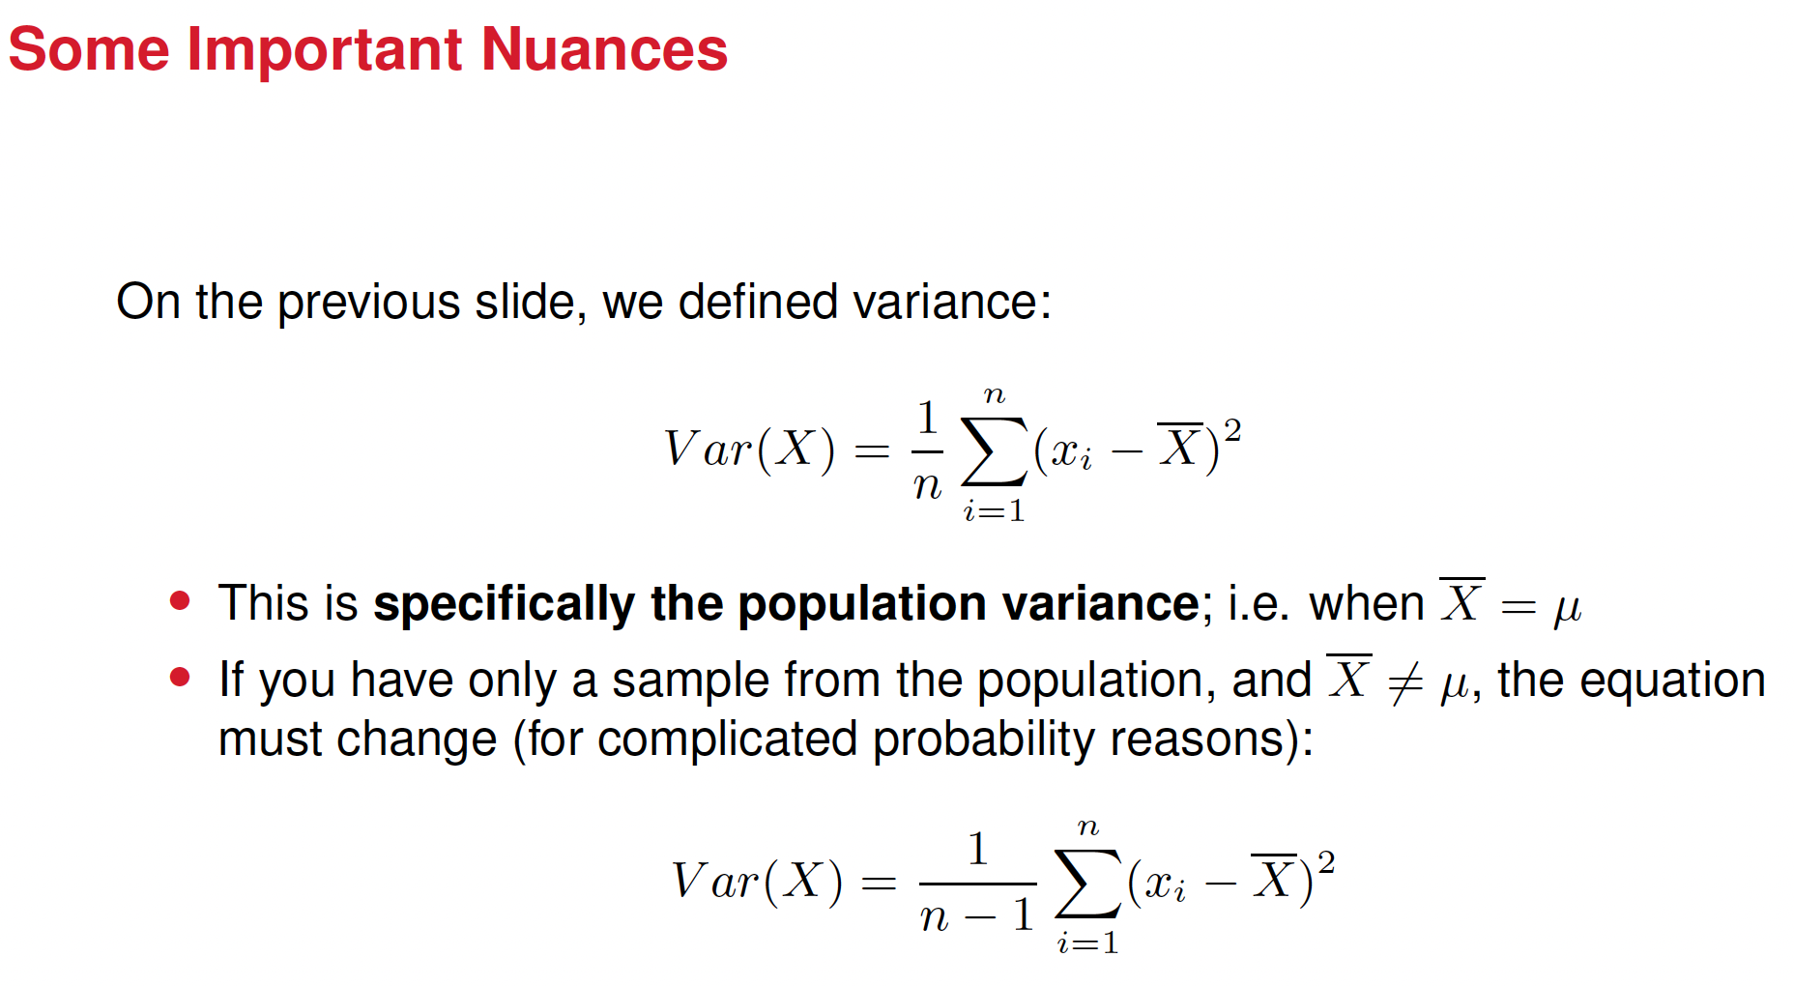

Slide 25
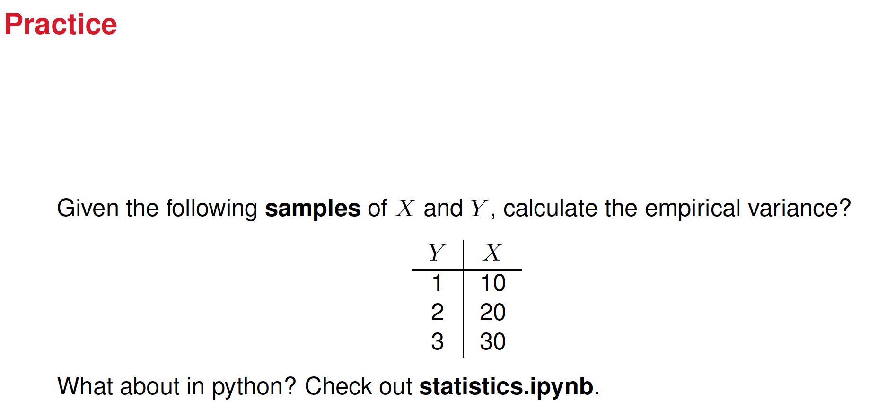

Slide 26
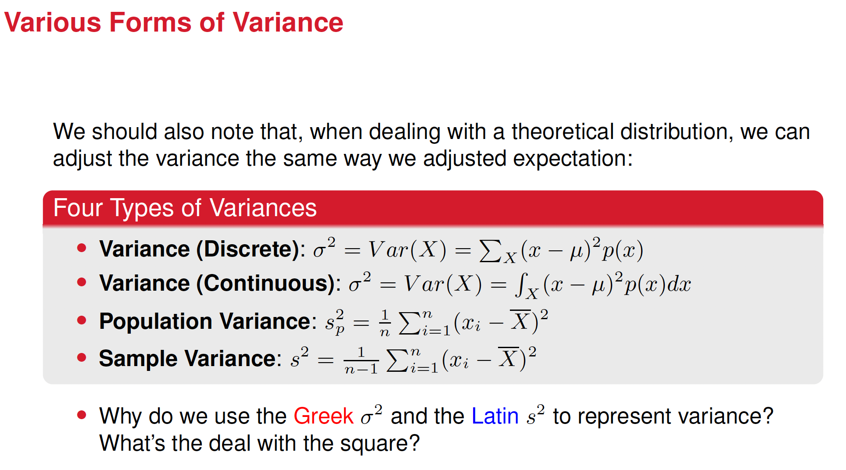

Slide 27
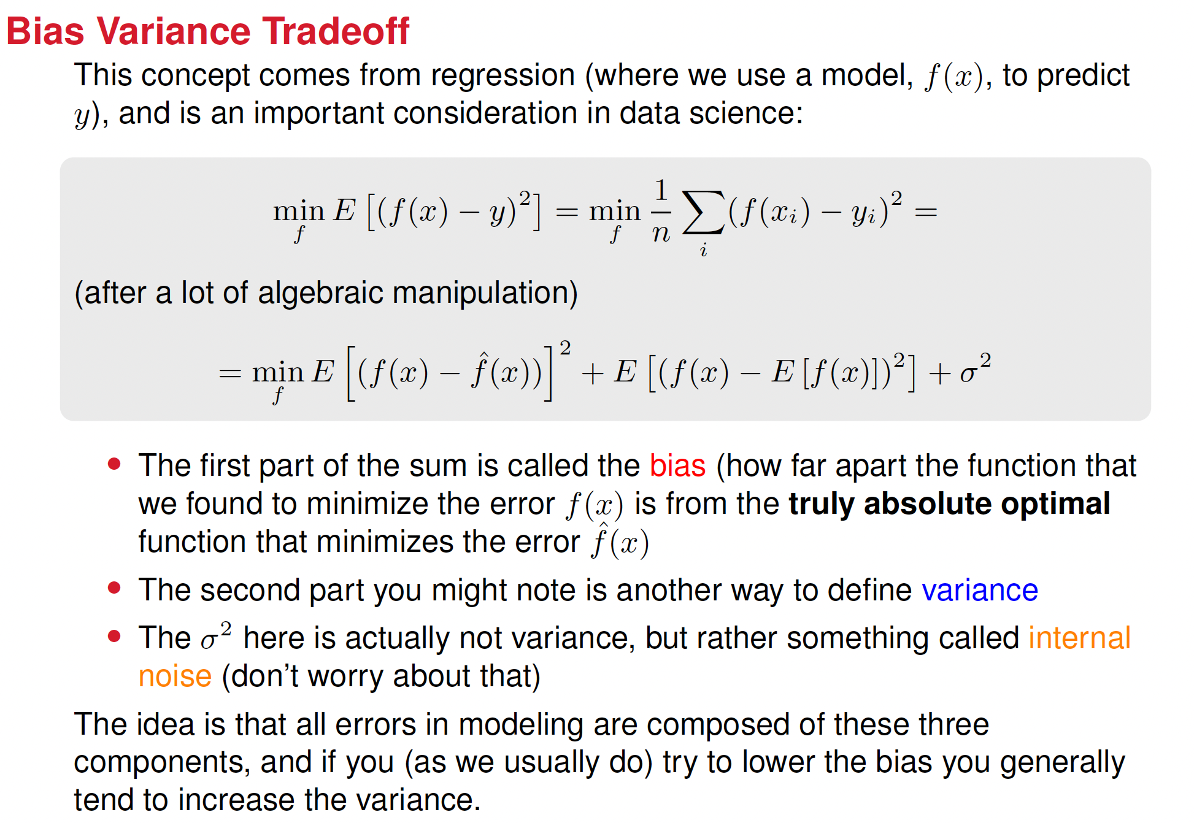
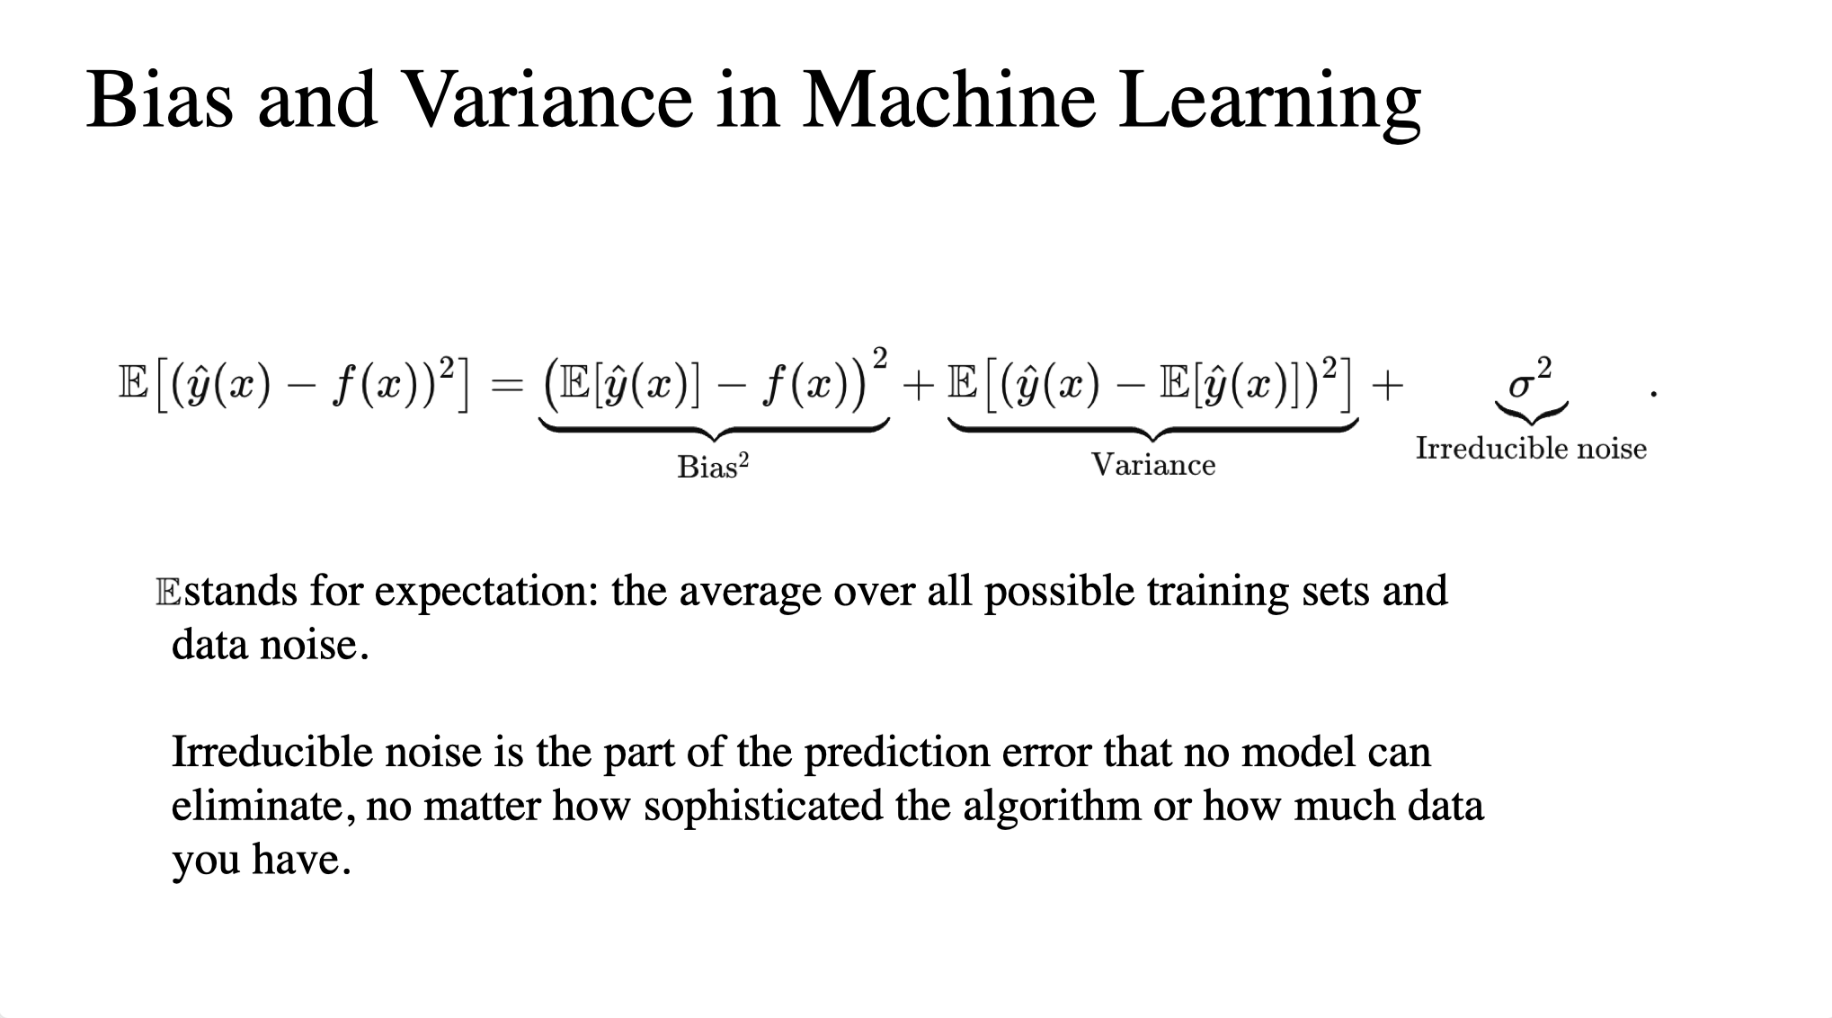

Slide 28
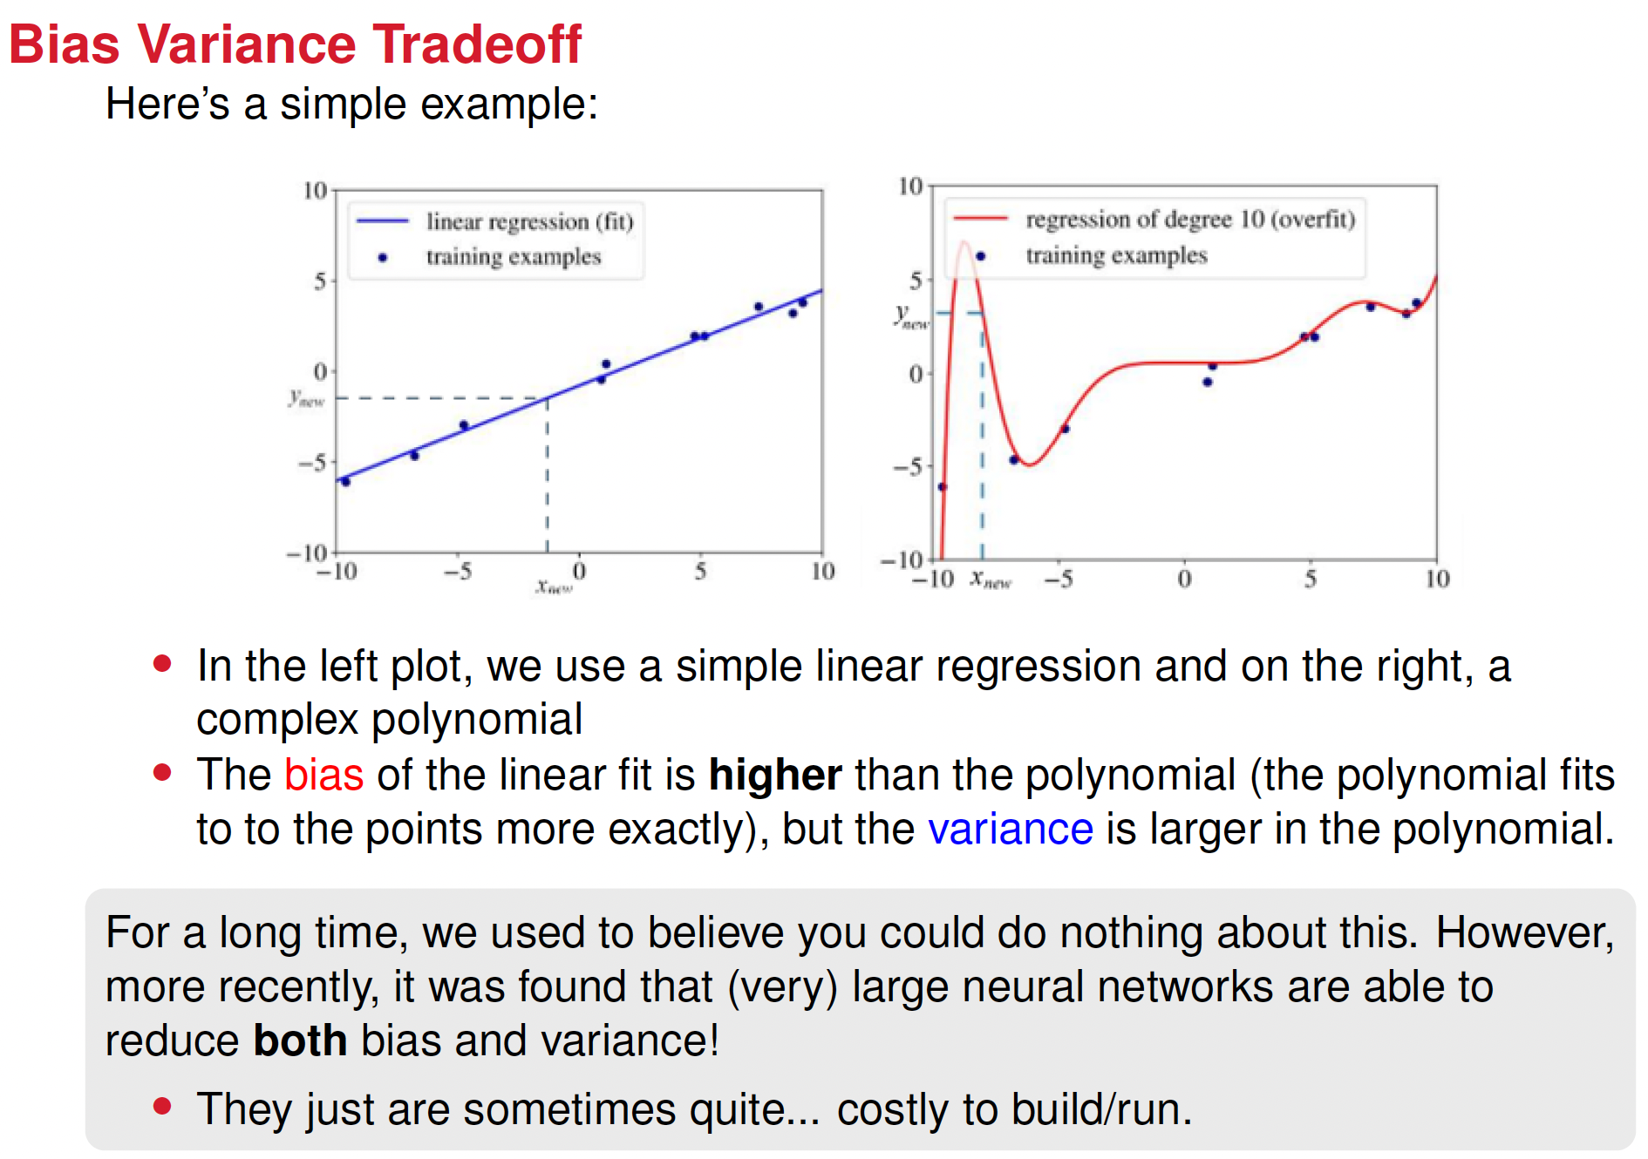

Slide 29
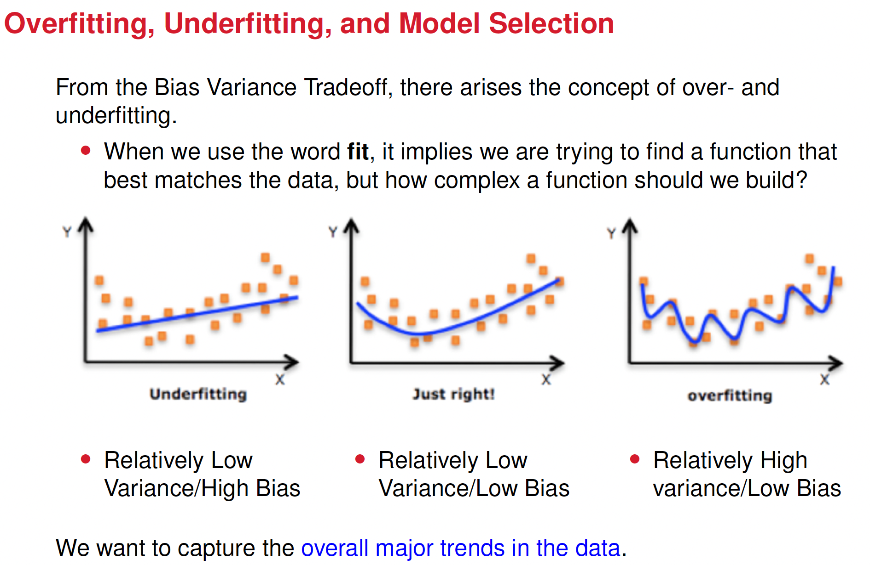

Slide 30
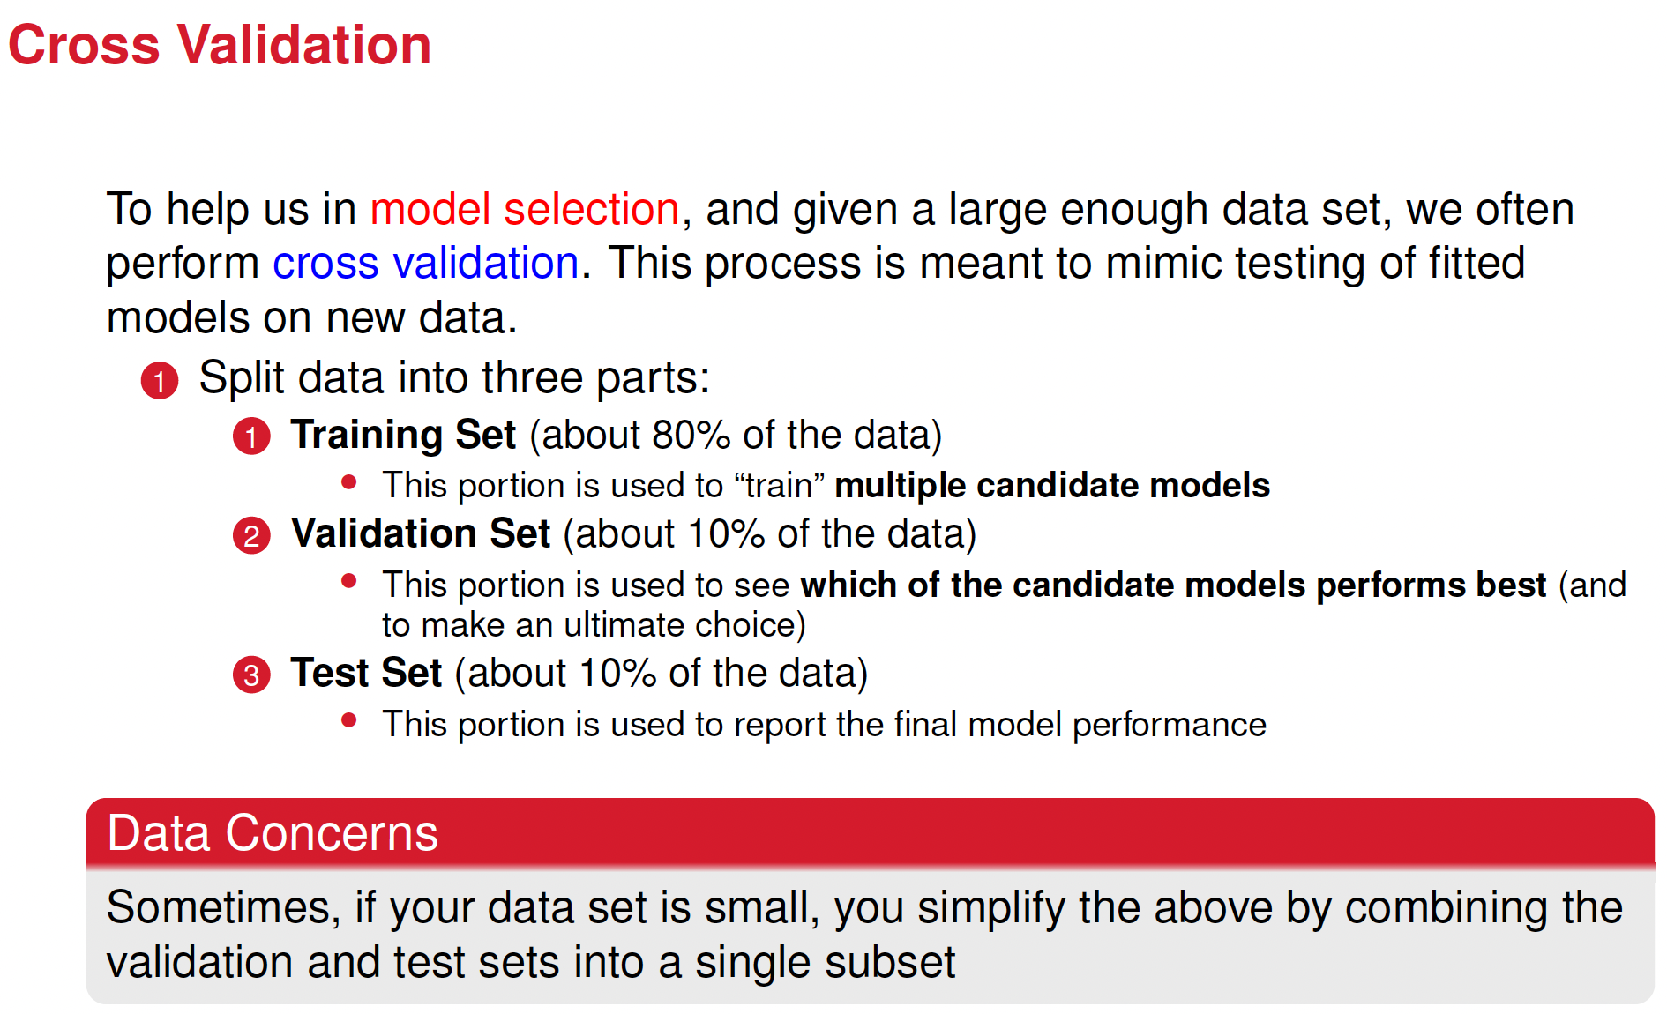

Slide 32









































Slide 33
Code examples:
statistics.ipynb
hold_out_bias_variance_error.ipynb

